Slide 1
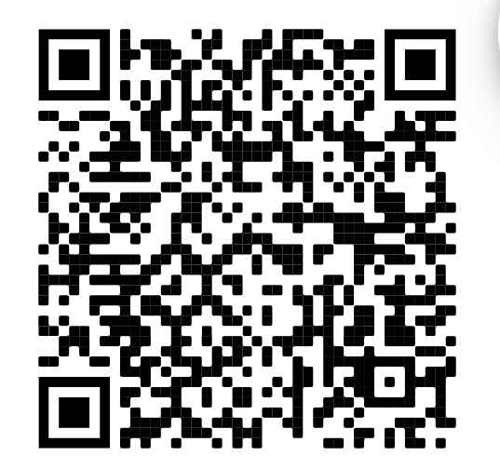
Welcome to WiCS!
Sign In here:

Slide 2
Upcoming Events & Announcements
SCI week is next week! Join us for a panel with experienced, successful women in tech
Monday, Sept 12 @ 1pm
Information Sciences Building, 3rd floor theater area
Thats all lol
Notes:
Erin

Slide 3
Overcoming Imposter Syndrome
Pitt WiCS
Notes:
Katelyn

Slide 4
“I don’t deserve this.”
“They’re going to find out I’m not supposed to be here.”
“I tricked everyone.”
“It must have been a mistake.”
“I just got really, really lucky.”
“I don’t belong here.”
Notes:
Katelyn
Maya Angelou
Albert Einstein

Slide 5
Impostor Syndrome
So...what is it?
When you internalize your success
Afraid of being exposed as a “fraud”
Uncomfortable with recognizing your hard work
Based on anxiety, NOT facts!
Symptoms
Self-confidence is GONE
Constant comparison to others
Distrust of your abilities
Dwelling in the past
Fearful of the future
Notes:
Katelyn
Impostor syndrome refers to the phenomenon when an individual internalizes their accomplishments, due to fear of being exposed as a “fraud.”
Those with imposter syndrome are psychologically uncomfortable with acknowledging their role in their own success, but their negative thoughts (often referred to as “cognitive distortions”) are based on anxiety, rather than objective facts.

Slide 6
What does Impostor Syndrome Look Like for Us?
Internships
Getting an offer
During
After it ends
Class
Assignments
Grades
Research
Opportunity
Publication
Etc.
It can really happen anywhere…
Notes:
Katelyn

Slide 7
What’s the Workplace Like?
50%
of women said they experienced gender discrimination at work.^{[2]}
Notes:
Katelyn
The numbers were even higher for women with a postgraduate degree (62%), working in computer jobs (74%) or in male-dominated workplaces (78%). When asked whether their gender made It harder to succeed at work, 20 percent of women said yes and 36 percent said sexual harassment is a problem in their workplace.
In addition to increasing the likelihood of gender-related discrimination against women, male-dominated workplaces pay less attention to gender diversity (43%) and cause women to feel a need to prove themselves all or some of the time (79%), according to Pew’s 2017 research. As a comparison, only 44 percent of women working in environments with a better gender-diversity balance said they experienced gender-related discrimination at work, 15 percent felt their organization paid “too little” attention to gender diversity and 52 percent said they felt a need to prove themselves.

Slide 8
Well, What About School?
21%
of 2019 B.S. CS & B.S. IS degree recipients were women.^{[4]}
Notes:
Katelyn
In addition to increasing the likelihood of gender-related discrimination against women, male-dominated workplaces pay less attention to gender diversity (43%) and cause women to feel a need to prove themselves all or some of the time (79%), according to Pew’s 2017 research. As a comparison, only 44 percent of women working in environments with a better gender-diversity balance said they experienced gender-related discrimination at work, 15 percent felt their organization paid “too little” attention to gender diversity and 52 percent said they felt a need to prove themselves.

Slide 9
But What’s the Representation in Tech?
26%
of computing jobs are held by women.^{[1][2][3][4]}
Notes:
Katelyn
47% of the workforce across all jobs are women

Slide 10
Ok, What’s the Representation in SWE?
14%
of software engineers are women, with only a 2% increase in the past 20 years.^{[1]}
Notes:
Katelyn

Slide 11
What do All These Numbers Mean?
Perception of women in the tech workplace can be skewed toward the negative
“It’s easier for you to get a job here because you’re a woman”
And several variants of this, that you’re a diversity hire
Negative feedback loop
Treatment → Impostor Syndrome → Discouraged → More Impostor Syndrome
Feeling like you must prove yourself
Important to Acknowledge:
Not everyone feels this way
But this doesn’t invalidate those who do!
Meritocracy isn’t real here
“If you’re actually worthy, you’ll be acknowledged!”
n o
Argument used by others to silence those climbing the uphill battle
Shouldn’t be made to feel like this in the first place
Notes:
Erin
God forbid a ~woman~ gets an offer to work somewhere great. Must be because she’s a girl
Contributes to the feeling of not

Slide 12
What Can Growth Mindset Sound Like?
I can’t do this yet
It doesn’t get easier, but you get better
Failure = learning opportunity
How can we overcome?
Going to WiCS ofc
Talking to your profs!
Form groups
Have confidence in yourself
Get in the mindset that everyone is on the same level as you
Notes:
Erin

